Slide 1





Accelerate .NET to Azure with GitHub Actions
Isaac Levin
Senior Product Marketing Manager
@isaacrlevin

Slide 2
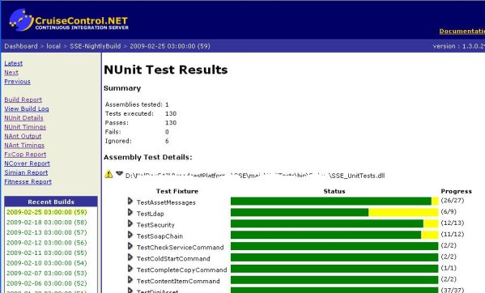




In the Beginning (well not really)
How did we get apps to Production before that CI/CD thing?
Copy / Paste ☺
FTP if you were fancy
Then tools started to show up (but not linked to Repo)
Finally complete CI/CD Tools!!!

Slide 3
What is a GitHub Action?
YAML-Powered Workflows linked to GitHub Repositories
Trigger Workflows with Webhook, Scheduled or Manual Events
GitHub-Hosted Runners pre-installed with tons of tools
Windows, Ubuntu or MacOS provided
Action Run logs available in GitHub Repo Portal
Community Marketplace of Actions and Workflows for nearly every need

Slide 4
It All Starts with setup-dotnet
GitHub Action to configure a dotnet cli environment
Ability to specialize specific version of .NET SDK (including previews)
Configure Environment to use Private Package Sources
Nuget, GitHub Packages, Azure DevOps Artifacts

Slide 5

Doing .NET Things in Actions
Demo

Slide 6
Where Can I Deploy To?
Azure App Service (obviously)
Azure Functions
Azure Static Web Apps
Azure Kubernetes Service
Really Anywhere Else!!!

Slide 7
When to Deploy to App Service
Traditional Web Applications (Razor Pages, MVC, Web Api, SS Blazor)
Scalable Production Workloads (high performance or even dedicated environments)
When you need a little more control over environment configuration but don’t need the whole OS
Rich feature-set like Slots, VNET Support and Azure Active Directory Integration

Slide 8
Deploy to App Service
Demo

Slide 9
When to Deploy to Azure Functions
Small Stateless Tasks (there are Durable Functions if state is needed)
App Infrastructure doesn’t matter
Event-driven architecture with triggers and bindings (non-Http things)
Extremely Cost Effective*

Slide 10
Deploy to Azure Functions
Demo

Slide 11
When to Deploy to Azure SWA
When you don’t need a server
Building Blazor WebAssembly with or without an Api
Automatic CI/CD Configured at App Creation
Free SSL Certs!!!

Slide 12
Deploy to Azure SWA
Demo

Slide 13
So To Summarize
Great solution to seamlessly configure CI/CD on your GitHub repos
Building and Deploying .NET Core Applications is painless with GitHub provided Workflows
Plethora of custom workflows including deployment to many Azure Services
Use GitHub Actions WHENEVER you want to deploy ASP.NET Core to Azure!!!

Slide 14
Visual Studio 2019 16.8 GA and 16.9 Preview
RELEASED
Dev environments in the cloud
.NET productivity
GitHub Codespaces available as a limited “preview” for ASP.NET Core, .NET Core and C++
Roslyn analyzers are now included in the .NET 5.0 SDK
.NET Code Style analyzers can now be enforced on build ^{Preview}
AI-assisted productivity
Linux diagnostics
Team Completions: Get C# contextual suggestions for your own types, through custom models shared with your team
.NET Core Debugging with WSL 2 using the Linux distro of your choice ^{Preview}
Debug managed Linux core dump
Automated CI/CD workflow ^{Preview}
XAML productivity
GitHub Actions workflow from within Visual Studio for your .NET Core apps
XAML Binding Failures diagnostic improvements
Git workflows
Easily execute your daily Git operations using the Git Changes window
Browse and manage your Git repository and stop worrying about merge conflicts
visualstudio.com/download aka.ms/vs-preview

Slide 15

Thanks for joining!
https://isaacl.dev/actions-dotnet-azure

Slide 16
Two columns of content

Slide 17
Demo

Slide 18
Code Sample
Code sample

Slide 19
Announcemnet
Value prop 1
Value prop 2
Value prop 3

Slide 20









Slide 21








Slide 22








Slide 23








Slide 24





Slide 25


Slide 26


Slide 27


Slide 28


Slide 29


